Slide 1
Computer Architecture

Slide 2
Index
Introduction of Computer
Computer Design Basics
Instruction set Architecture
RISC/CISC CPU
I/O and Communications
Memory Basics and Systems
Advanced Architecture

Slide 3
References
Morris M. Mano, Digital Design And Computer Fundamental, 4th Ed. Pearson International Publisher, 2008
Morris M. Mano, Computer System architecture, 3rd Ed. Pearson International Publisher
Tanenbaum, Computer System Organization, 5th Ed. Pearson International Publisher, 2006

Slide 4
Introduction of Computer
Chapter 1.
1-1
Computer Organization
Milestones in Computer Architecture
Computer Families

Slide 5
Computer Organization
1-2
2025 ; 전인류 → programmer (Stanford 연구소)
-현재 Computer 의 결점
1. 융통성 결여
2. I/O 가 불완전
3. 자연언어 이해 불가능
- H/W ; 1000배/10년 (2배/1년)
- S/W ; 2배/10년 (6~7% 증가/1년)
Numeric P. → Symbolic P.

Slide 6
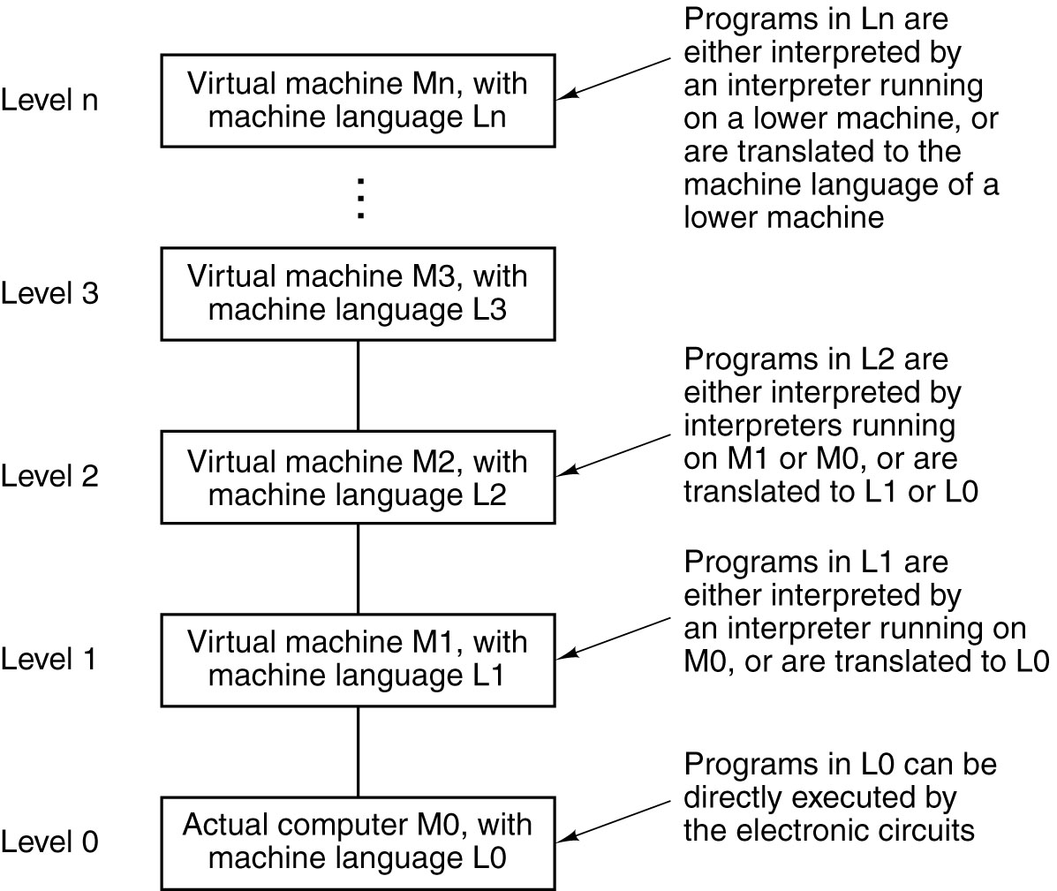
Language, Levels, Virtual Machines
1-3
A multilevel machine

Slide 7
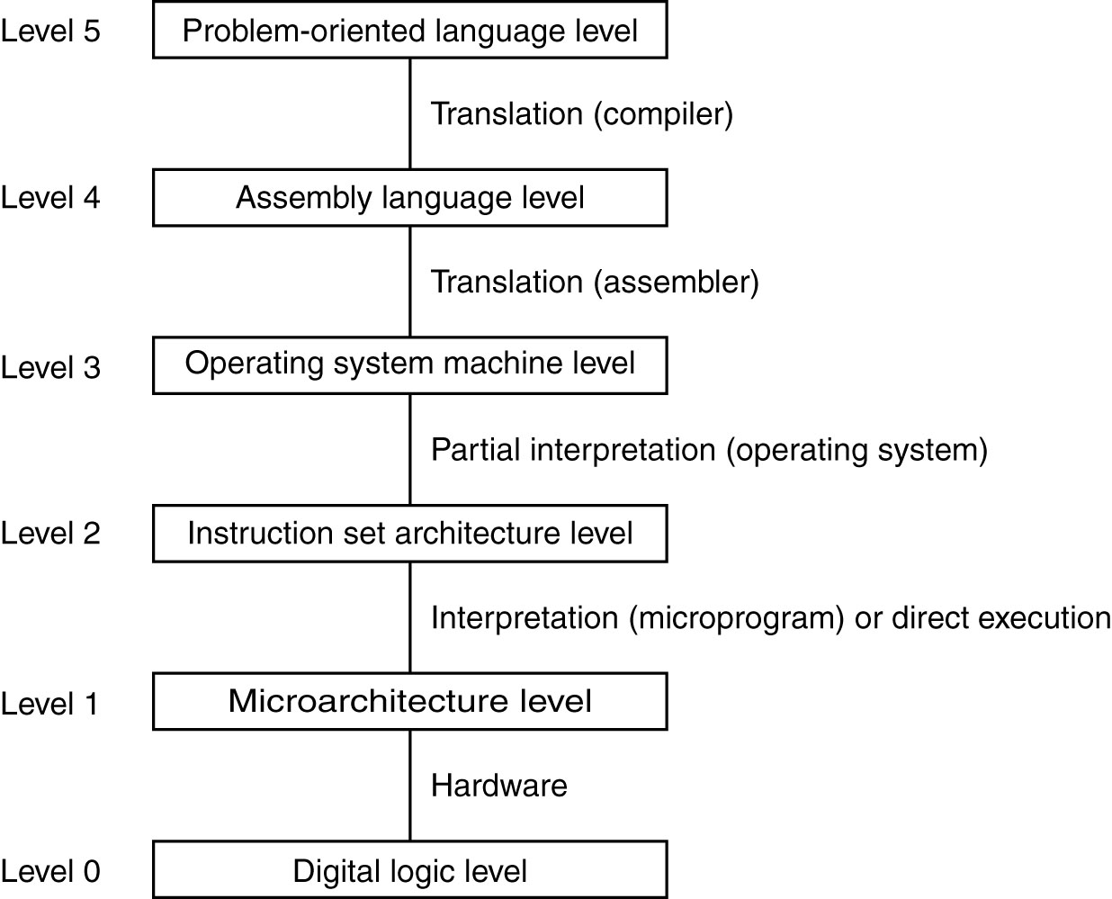
Contemporary Multilevel Machines
1-4
A six-level computer.
The support method for each level is indicated below it .

Slide 8
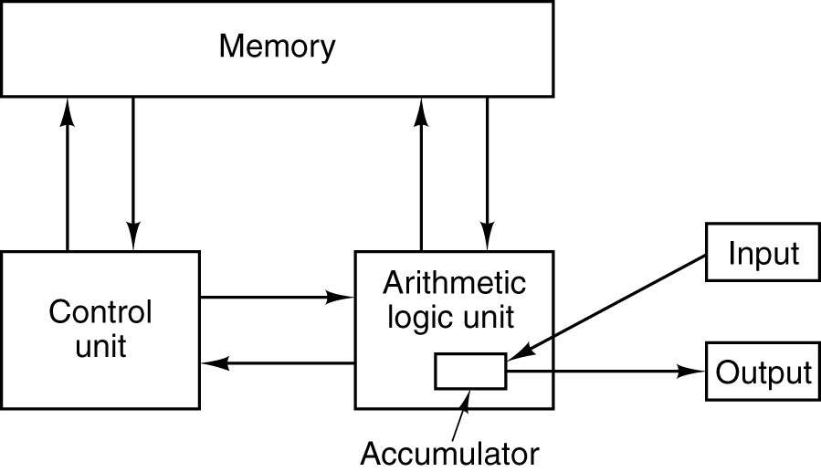
Von Neumann Machine
1-5
The original Von Neumann machine.

Slide 9
Evolution of Multilevel Machines
1-6
  H/W and S/W are logically equivalent
Invention of microprogramming
    H/W → S/W ( logically equivalent )
1951, Wilkes ( univ. of Cambridge )
Invention of operating system
    FMS → IBM 709
Migration of functionality to microcode
+ - * /, arrays, loop, interrupt, I/O, multimedia
Elimination of microprogramming
cisc → risc

Slide 10
Computer Generations
1-7
Zeroth Generation (1642 – 1945)
    Mechanical Computers
First Generation (1945 – 1955)
    Vacuum Tubes ; Numeric calculation
Second Generation (1955 – 1965)
    Transistors ; Stored Program
Third Generation (1965 – 1980)
    Integrated Circuits ; TSS
Fourth Generation (1980 – ?)
    Very Large Scale Integration ; Computer Network
Fifth Generation (1990-- )
    Artificial Intelligence ; Invisible computers
Ubiquitous Computing (2000 -- )
    Imbedded system ; Sensor Network

Slide 11
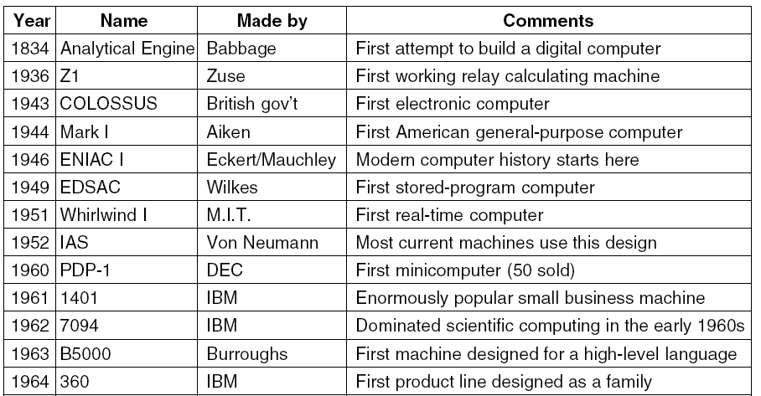
Milestones in Computer Architecture (1)
1-8
Some milestones in the development of the modern digital computer.

Slide 12
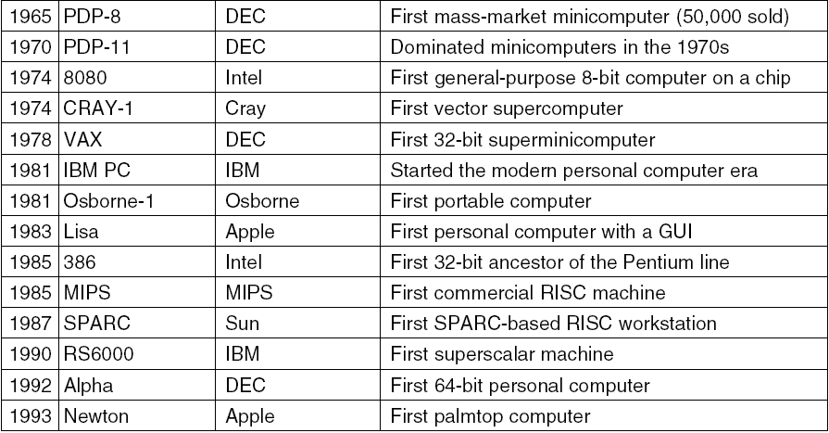
Milestones in Computer Architecture (2)
1-9
Some milestones in the development of the modern digital computer.

Slide 13
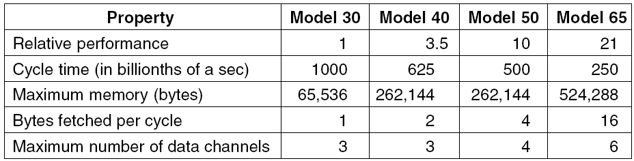
IBM 360 Families
1-10
The initial offering of the IBM product line.

Slide 14
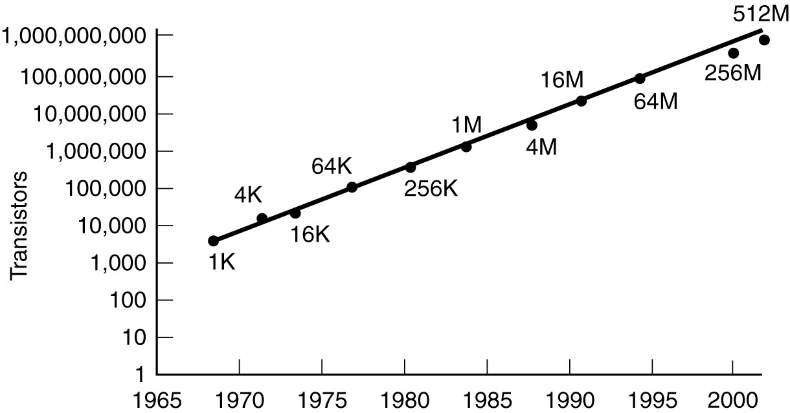
Technological and Economic Forces
1-11
Moore’s law predicts a 60-percent annual increase in the
number of transistors that can be put on a chip.
The data points given in this figure are memory sizes, in bits.

Slide 15
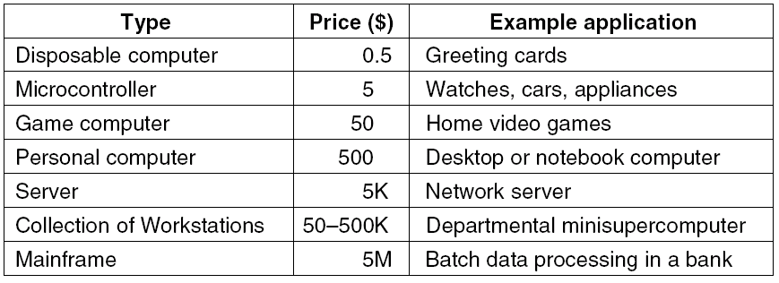
The Computer Spectrum
1-12
The current spectrum of computers available. The prices should
be taken with a grain (or better yet, a metric ton) of salt.

Slide 16
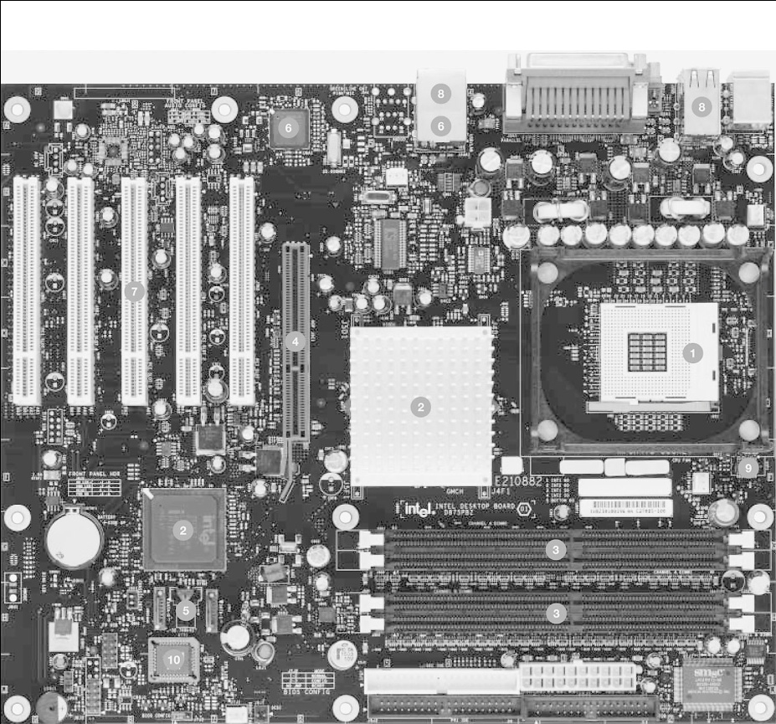
Personal Computer
1-13
1. Pentium 4 socket
2. 875P Support chip
3. Memory sockets
4. AGP connector
5. Disk interface
6. Gigabit Ethernet
7. Five PCI slots
8. USB 2.0 ports
9. Cooling technology
10. BIOS
  A printed circuit board is at the heart of every personal computer. This figure is a photograph of the Intel D875PBZ board. The photograph is copyrighted by the Intel Corporation, 2003 and is used by permission.

Slide 17
Computer Families
1-14
Pentium 4 by Intel
Ultra SPARC III by Sun Microsystems
The 8051 chip by Intel, used for embedded systems

Slide 18
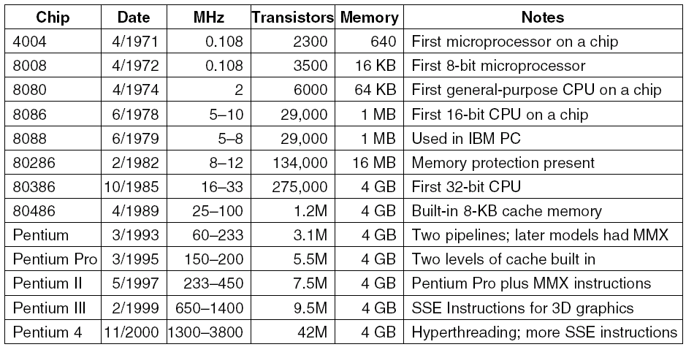
Intel Computer Family (1)
1-15
The Intel CPU family. Clock speeds are measured in MHz (megahertz) where 1 MHZ is 1 million cycles/sec.

Slide 19
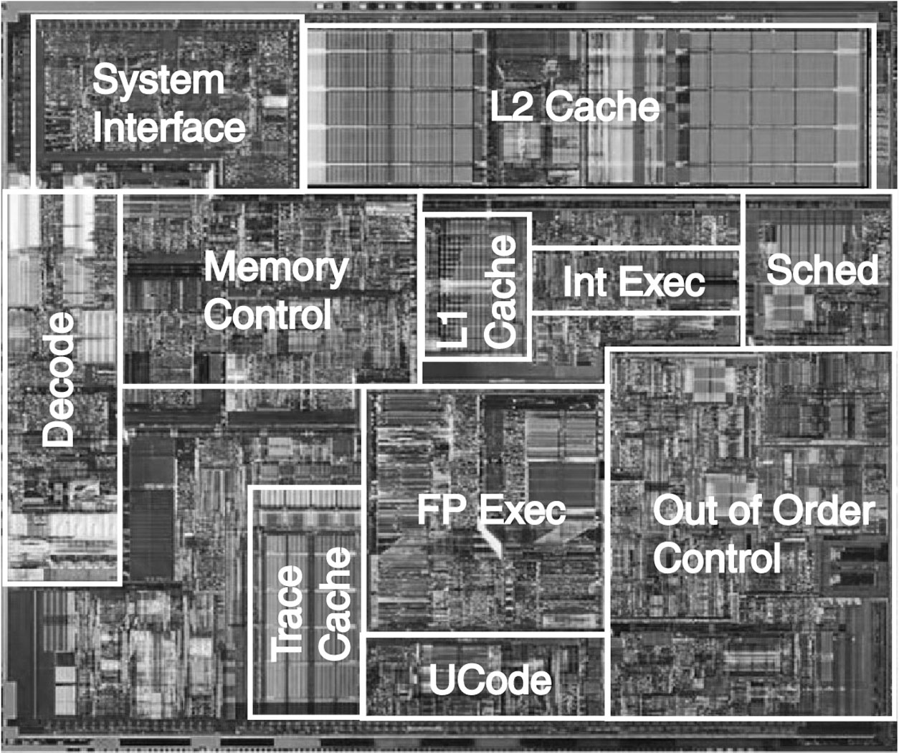
Intel Computer Family (2)
1-16
The Pentium 4 chip. The photograph is copyrighted by the Intel Corporation, 2003 and is used by permission.

Slide 20
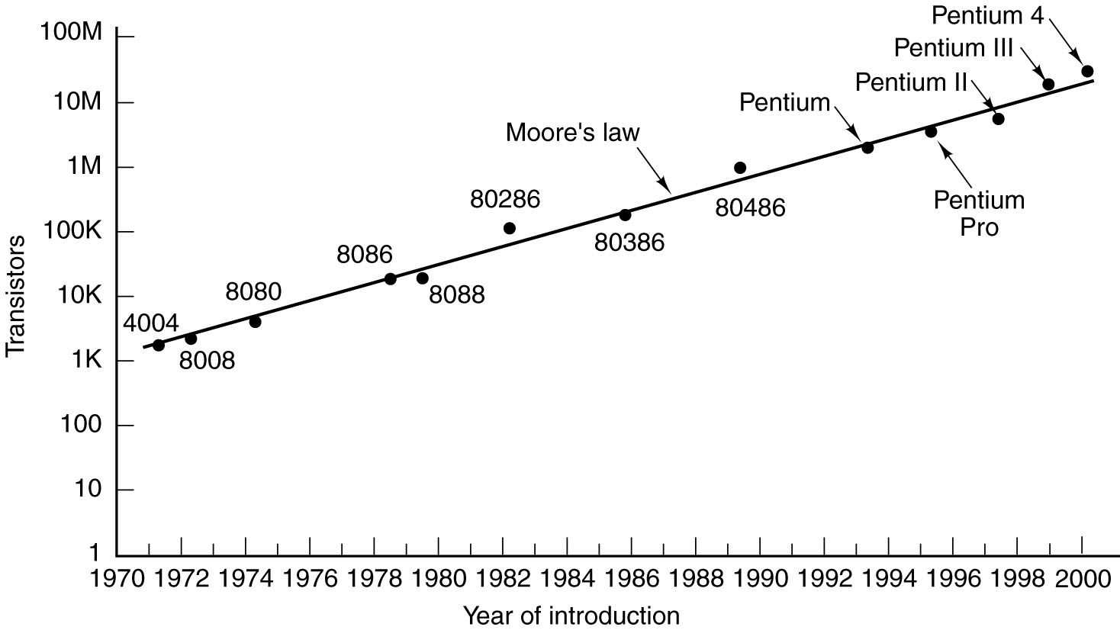
Intel Computer Family (3)
1-18
Moore’s law for (Intel) CPU chips.

Slide 21
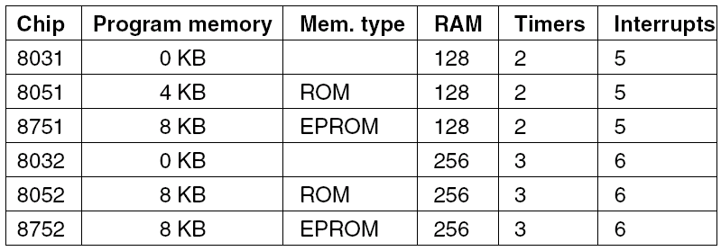
MCS-51 Family
MCS-51 Family
1-19
Members of the MCS-51 family.

